Slide 1

“To Those Who Want to be
Under the Law”
4:21 – 31
Week 10
23 March 2022

Slide 2

Galatians Overview
Last lesson, we discussed the idea of caring enough to tell the truth. Paul knows that something has gone seriously wrong with the Galatians. He remembers their care for him when he was ill — perhaps with an illness affecting his eyesight. They would have given their eyes to him in those days (12-16).
But now they seem to have lost all their joy and commitment (zeal). We don’t like to think that we’re helpless — but we are! Pride in what we can do must be replaced by humble acceptance of what Jesus has done for us. If our works could deliver salvation, Jesus need never have gone to the cross. Paul sees the Galatian Christians as his little children; having travail in birth pains to bring them to salvation in Christ (17-20).

Slide 3
Galatians Overview
Paul’s final argument is another example to show the difference between law and promise. He uses the very scriptures which the Jewish teachers are using to impose the law on Gentile Christians. He reminds them of Abraham's two sons by Sarah and Hagar, and contends there are allegorical implications concerning the two covenants (21-22).
Paul takes the Jews to the books of the law and the story of Abraham. Abraham had two sons. The first was Ishmael, the child of his slave woman Hagar. The second was Isaac, the child of his wife Sarah. One was born a slave; the other was born free.

Slide 4
Galatians Overview
Hagar, the bondwoman who gave birth to Ishmael, represents the covenant given at Mt. Sinai, and corresponds to physical Jerusalem and the bondage of those under the Law (24-25).
Sarah, Abraham's wife who gave birth to Isaac, represents the new covenant and corresponds to the heavenly Jerusalem which offers freedom to all who accept it (26-28).
With a reminder that those born of the Spirit can expect persecution by those born according to the flesh, Paul concludes his defense of the gospel of justification by faith in Christ by proclaiming that those in Christ are not of the bondwoman but of the free (29-31).

Slide 5

“To Those Who Want to be
Under the Law”

Slide 6
Galatians Allegory
Swindoll offers the following for our edification:
Throughout history, both Judaism and Christianity have wrestled with the question, “How should we interpret the Bible?” Because the Bible itself contains no preface that sets out specific principles of interpretation, many answers to this question have been offered.
Nevertheless, two tendencies of reading the Bible have prevailed throughout history—the literal and the allegorical. One group, centered at Antioch in Syria, preferred to emphasize a literal approach to reading the Bible. They believed that it was important to bring out the concrete historical realities of the biblical text. And they wanted to teach the events of biblical history as events, with special attention paid to the literary context.

Slide 7
Galatians Allegory
Swindoll offers the following for our edification:
And they wanted to teach the narratives of biblical history as events, with special attention paid to the literary and historical context.
The second group tended toward an allegorical reading. These believers emphasized the spiritual meaning behind the historical reality, a meaning that points readers to the doctrine of the church.
Allegorical interpretation has been defined as “searching for a hidden or a secret meaning underlying but remote from and unrelated in reality to the more obvious meaning of the text.”

Slide 8
Galatians Allegory
Swindoll offers the following for our edification:
Allegories became popular among Jewish interpreters who wanted to make the Old Testament relevant for contemporary life or to explain embarrassing stories or even books.
So, for example, though the Song of Solomon appears to refer to a romantic relationship between a lover and his beloved, the allegorists reinterpreted it spiritually to refer to God’s loving relationship with Israel.

Slide 9
Galatians Allegory
Swindoll offers the following for our edification:
When we compare Paul’s brief allegory in Galatians 4 with the excessive and even bizarre allegorical interpretations, we encounter in some Jewish and Christian writings, Paul’s approach seems rather tame.
In any case, in the context of his argument, Paul used allegory to catch the attention of his readers and turn the Judaizers’ method of interpretation against them.

Slide 10
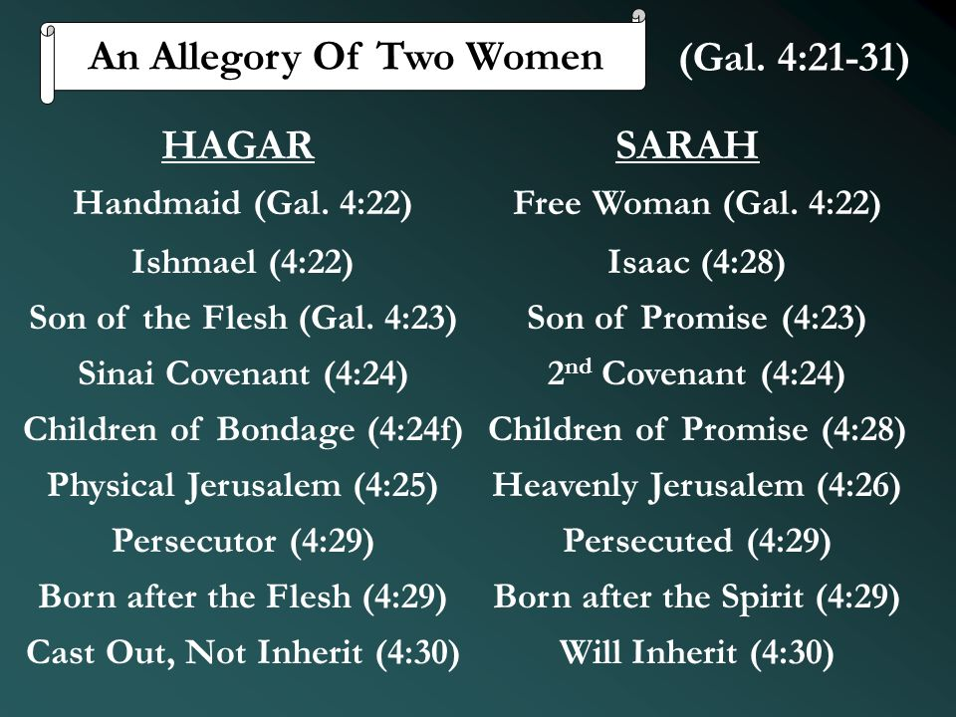

Slide 11
Galatians 4:21
²¹Tell me, you who want to be under the law, are you not aware of what the law says?

Slide 12
Galatians 4:21
The Galatians had not yet submitted to the bondage of the Law but they desired to. Paul desperately wanted to stop them from “backsliding” and to turn them back to a life under grace. As a transition to what would immediately follow, he challenged the Galatians to be “aware of” or to understand what the Law really said.
Paul begins with a pointed, perhaps even sarcastic, question: “Tell me, you who want to be under the law, do you not listen to the Law?” Paul asks those Judaizers and the Galatians, “You think that living by the Law is the way to go? Great! Then listen to what the Law itself says!” Paul grants his opponents premise—that we are obligated to follow everything the Law says. Then Paul turns this premise against them.

Slide 13
Galatians 4:21
Paul never compromised his convictions, but he never hesitated to forsake his comfort, to think outside the box, or to reach down (or up) to the level where people were.
So, here in Galatians 4:21-31, Paul engages in a method of argument rarely seen in the New Testament, but which would have been quite familiar to his audience: allegorical interpretation of Scripture.

Slide 14
Galatians 4:22 – 26
²²For it is written that Abraham had two sons, one by the slave woman and the other by the free woman. ²³His son by the slave woman was born according to the flesh, but his son by the free woman was born as the result of a divine promise. ²⁴These things are being taken figuratively: The women represent two covenants. One covenant is from Mount Sinai and bears children who are to be slaves: This is Hagar. ²⁵Now Hagar stands for Mount Sinai in Arabia and corresponds to the present city of Jerusalem, because she is in slavery with her children. ²⁶But Jerusalem which is above is free, which is the mother of us all.

Slide 15
Galatians 4:22 – 26
The Jews arrogantly boasted that they were the descendants of Abraham, citing their genealogical pedigree as proof of their high spiritual standing before God. Most Jews in Paul’s day believed that their physical relationship with Abraham put them in proper standing before God. Because they were physical products of Abraham’s seed, they thought they were heirs to God’s promises and blessings.
Paul deals a death blow to the belief in salvation by inheritance by retelling the story of Abraham and the sons he had through Hagar and Sarah (4:22-23). People aren’t born Christians—they become Christians.

Slide 16
Galatians 4:22 – 26
By turning again to Abraham, Paul was appealing to the founder of the Jewish nation from whose physical descent the Jews traced their blessings. John the Baptist and Jesus declared that physical descent from Abraham was not enough, however, to guarantee spiritual blessing.
Paul reminds the Galatians that Abraham had two sons (those born later were not important to Paul’s illustration), and that they should consider which of the two sons they were most like.
One son, Isaac, was born of Sarah, the free woman; the other, Ishmael, was born of Hagar, the slave woman. In accordance with ancient law and custom, the status of a mother affected the status of her son (4:22-23).

Slide 17
Galatians 4:22 – 25
A second contrast concerned the manner in which the sons were conceived. Ishmael was born in the ordinary way, that is, in the course of nature and requiring no miracle and no promise of God. Abraham attempted to lend God a helping hand by siring an heir through his servant girl, Hagar. God’s simple, straightforward promise that Abraham would have a child through the aged and barren Sarah seemed too steep a mountain to climb.
So, reinterpreting the promise as a challenge, Abraham took matters into his own hands and produced Ishmael through natural, or “fleshy,” means (4:23).

Slide 18
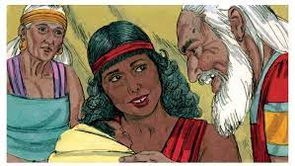
The Birth of Ishmael to Hagar

Slide 19
Galatians 4:22 – 26
Isaac, on the other hand, was born to the “free woman,” Abraham’s wife Sarah, “through the promise” (4:23). In other words, Isaac was a miracle child, born when Abraham was one hundred years old and Sarah was ninety. God opened Sarah’s womb and brought Isaac into the world against all odds—against nature itself! Yet the miraculous birth of Isaac came about just as God had promised.
Emphasizing the contrast between Law and grace, Paul uses this historical events as an allegory; treating the two mothers figuratively. Paul does not deny the literal meaning of the story, but declares that the story, especially the matters relating to the conception of the two sons, has an additional meaning. Thus Paul compares the narrative to the conflict between Judaism and Christianity.

Slide 20
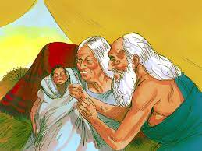
The Birth of Isaac to Sarah

Slide 21
Galatians 4:22 – 26
First, the apostle pointed to two covenants.
The Mosaic covenant, which had its origin at Mount Sinai and received its highest expression in the temple worship at Jerusalem. Those under this legal covenant were slaves and are still in bondage to the Law (4:25).
As Hagar brought forth a slave, so does the Law. At this point the reader is expected to understand and supply the implicit reference to the Abrahamic covenant, a more gracious covenant represented by Sarah which through its messianic promise brought forth children who are free (4:26).

Slide 22
Galatians 4:22 – 26
Secondly, Paul pointed to two Jerusalems.
Hagar also stood for the first-century city of Jerusalem, a city enslaved to Rome and in slavery to the Law. The earthly Jerusalem is the same — the capital of a Judaism which is enslaved to ritual, sacrifice and legalism (4:25).
Sarah, on the other hand, corresponded to the new Jerusalem in heaven, the mother of all the children of grace. The new Jerusalem, like Abraham’s wife, is free — and her children are free. This heavenly city, which one day will come to earth (cf. Rev. 21:2), is now the “city of the living God” (cf. Heb. 12:22), the home of departed believers of all ages (4:26).

Slide 23
Galatians 4:27
²⁷For it is written: “Be glad, barren woman, you who never bore a child; shout for joy and cry aloud, you who were never in labor; because more are the children of the desolate woman than of her who has a husband.”

Slide 24
Galatians 4:27
Paul shores up his argument for the superiority of grace over law by quoting Isaiah 54:1, a joyous hymn declaring the abundant fruitfulness of the woman who was once barren. The quotation from Isaiah 54:1 prophesied the changing fortunes of Israel, which Paul applied to Sarah’s history. Israel, before her Babylonian captivity, was likened to a woman with a husband. The barren woman was Israel in captivity. The woman bearing more children may have pictured Israel restored to the land after the Exile, but more particularly it portrays her millennial blessings.
Paul applied this passage (he did not claim it was fulfilled) in this context to Sarah, who though previously barren, was later blessed with a child, and who would ultimately enjoy a greater progeny than Hagar (4:27).

Slide 25
Galatians 4:27
The real children of Abraham are not the Jews who observe circumcision and keep the Sabbath. The real children of Abraham are those who, by faith in Christ, have become the children of God. This theology directly challenged the Judaizers’ claim that only participants in the old covenant of the Law could be blessed by God.
Paul is arguing with the Jewish teachers on their own ground — and winning. He wants them to realize the limitations of the law — and accept instead the freedom of Christ. Whoever chooses Law (Hagar) for his mother is going to experience bondage (4:25). But whoever chooses Grace (Sarah) for his mother is going to enjoy liberty in Christ. God wants His children to be free (4:23).

Slide 26
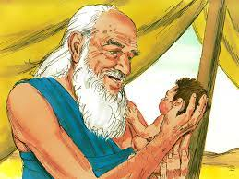
Abraham Holding Isaac

Slide 27
Galatians 4:28 – 31
²⁸Now you, brothers and sisters, like Isaac, are children of promise. ²⁹At that time the son born according to the flesh persecuted the son born by the power of the Spirit. It is the same now. ³⁰But what does Scripture say? “Get rid of the slave woman and her son, for the slave woman’s son will never share in the inheritance with the free woman’s son.” ³¹Therefore, brothers and sisters, we are not children of the slave woman, but of the free woman.

Slide 28
Galatians 4:28 – 31
If, like the Galatians, you have put your faith in Jesus Christ, you are a child of the free woman, Sarah—a child of promise (4:28). Just as Isaac was supernaturally born as a result of God’s promise, so all Christians are “born again” as a result of God’s promise that all nations would be blessed through Abraham (Gen. 22:18).
Yet Paul draws a final essential parallel between Isaac and Ishmael that related directly to the Galatian situation—and to our own battle with legalism. Until Christ returns, the children of freedom should expect to be persecuted by their legalistic half brothers. Just as Ishmael ridiculed and scorned Isaac (Gen. 21:8-9), so legalists will persecute believers (4:29).

Slide 29
Galatians 4:28 – 31
Paul’s closing argument climaxes with a coup de grace (4:30). Quoting Genesis 21:10-12, Paul notes that Abraham ultimately exiled Hagar and her child Ishmael because of the irreconcilable differences between Ishmael and Isaac.
His point is clear: Christians must reject legalism and refute those who teach it. Though Jews would have interpreted this passage as a mandate to reject Gentiles, Paul turns the tables, connecting the Judaizers with the slave woman and all Christians—Jews and Gentiles—with the free woman (4:31). All who have trusted Christ by faith are free!

Slide 30

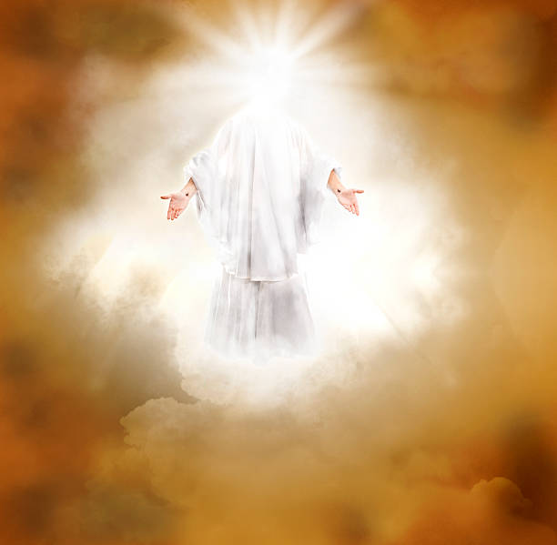

Slide 31
NEXT CLASS – 30 March 2022
Book of Galatians
Before next class, read the below verses in the KJV and the NIV, plus one additional versions of the Bible, i.e., NRSV, NLT, NKJV, etc …
Chapter 5:1 – 12
“Freedom, Faith, Love, and Truth”
EBC Website for Handouts
https://bit.ly/surveyofpaulineepistles

